Slide 1
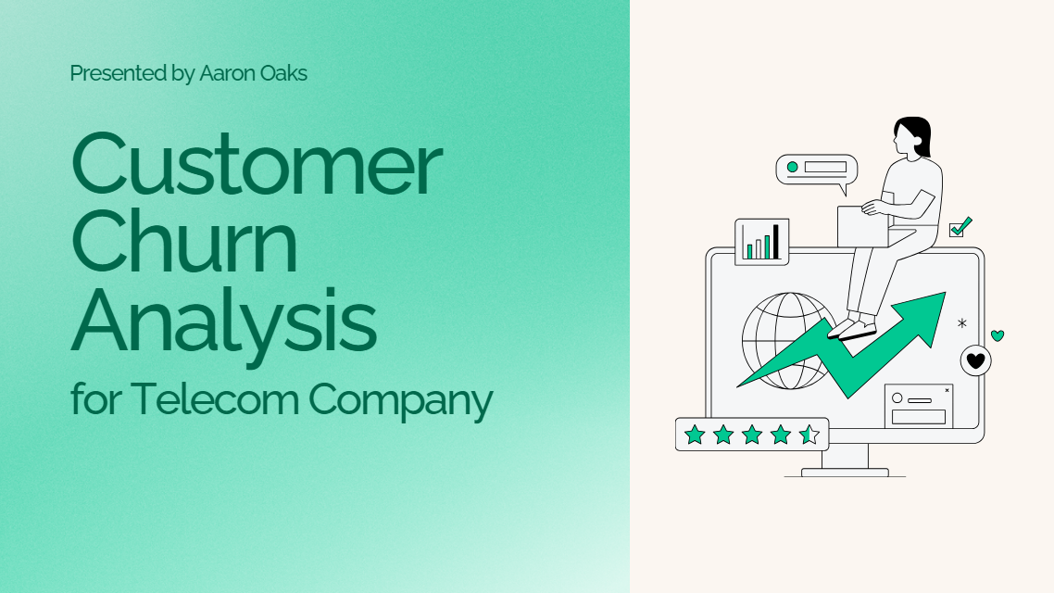
Notes:
Today we’ll be going over a quick in depth analysis look at Telecom’s Churn and what they can do to improve areas they may be experiencing the impacts.

Slide 2

Notes:
Slide 2 - The problem: Identify the problem from the start in storytelling.
Talk: First off I'd like to ask the audience, "If you could keep your customers from ever leaving your service, would you know where to look? How would you go about understanding their problems and how would you use it to your advantage? - rhetorical question to draw the audience in quickly.
Story: Imagine your business as a bucket filled with water, and this water represents your revenue and customers. The bucket has several holes at the bottom, and each hole represents a reason customers leave: price dissatisfaction, poor service, or better competitors' offers.
Talk: Long story short, No matter how much water you pour into the bucket (new customers), if the holes aren’t patched (churn), the bucket will eventually empty out, so how do we stop them?
Churn isn’t just about filling the bucket—it’s about understanding why the holes exist and strategically closing them.
Our goal to the problem will be explored in the data and we'll identify the key attributes
Mission quest goal:
By reducing churn, your businesses can build a loyal customer base, which not only ensures stable revenue streams but also drives positive word-of-mouth and long-term brand growth. A small reduction in churn can lead to a significant increase in revenue over time. So, understanding churn isn’t just about numbers—it’s about creating better customer experiences and ensuring business sustainability.

Slide 3
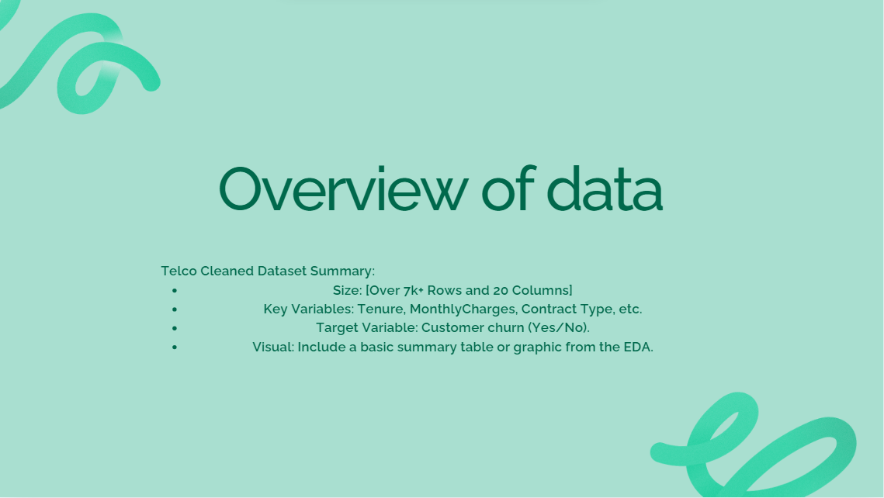
Notes:
- Story/talk - explain the threat (churn) Why should they care? Revenue. WHAT IS CHURN????
Story: "Imagine your customer base as water in a bucket."
"The goal is to keep the bucket full. But every time a customer leaves, it's like water leaking out through holes in the bucket."
The Problem: "The more holes (churn), the harder it is to keep the bucket full, no matter how much new water you add (new customers)."
Impact: "If we can't fix these holes, we spend more energy (money and resources) trying to pour in new water than actually keeping the bucket full. This is why understanding and reducing churn is critical."
Revenue Loss: When customers leave, businesses lose not only the immediate revenue but also the potential lifetime value of those customers. Retaining existing customers is significantly more cost-effective than acquiring new ones.
For example: High churn rates in telecom can lead to millions of dollars in lost revenue annually.
Brand Perception: High churn often signals dissatisfaction with products or services, potentially damaging the company's reputation. (word of mouth goes a long way)
Operational Costs: Attracting new customers requires marketing and onboarding costs, adding financial strain if churn isn’t mitigated.
Talk: With over 7K rows and 20 attributes to explore I’ll simplify it for you. “Imagine your business as a bucket filled with water, and this water represents your revenue and customers.
Well your bucket has server holes at the bottom and each hole is a reason why customers leave. (e.g. price dissatisfaction, poor service, or better competitive offers.
No matter how many new customers you bring in (water you fill), unless those holes and issues aren't patched up, your bucket will eventually empty out.
Ending: It is just as important to implement more effective strategies in patching these issues to ensure your bucket stays filled and - but remember - Churn isn’t just about filling the bucket—it’s about understanding why the holes exist and strategically closing them.
Transition: Let's take a look at the data.

Slide 4
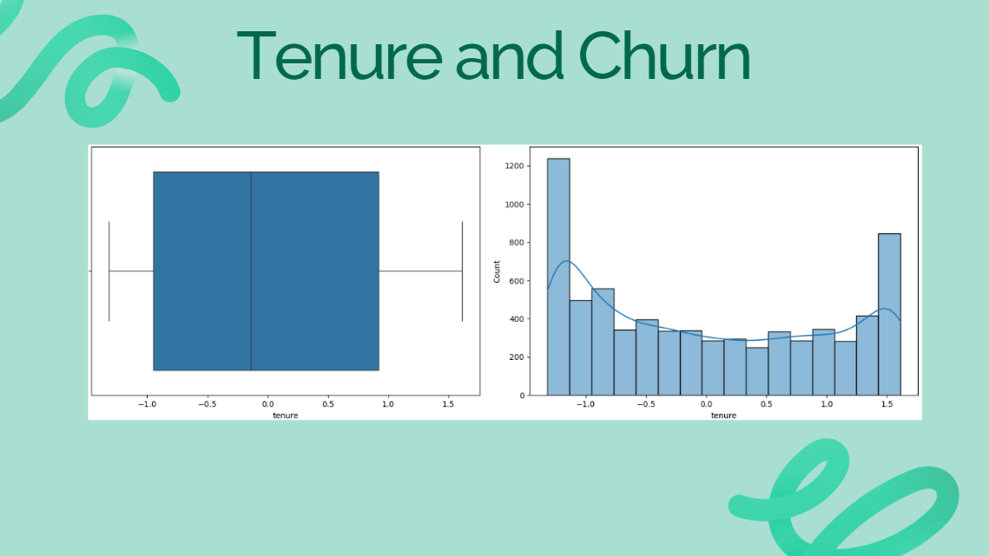
Notes:
Exercise Steps (Rubric) - Count Issues & Correlations.
- Bar plots, histograms Visuals
- Correlations? Trends?
Tenure: Length of customer relationship. What is Tenure x Churn? Customers who spend less time with the company have a higher likely chance in leaving, we can see Churn rates decrease as Tenure Increases.
Story: Now, think of your customers as trees in a forest that you’re responsible for cultivating.
The trees that have been planted longer (high tenure customers) are stronger and deeply rooted, meaning they are less likely to leave. Newly planted trees (short tenure) are fragile and need extra care (promo’s, deals, offers, upgrades, to ensure they like you, that they want to continue their growth with you) to ensure they grow and stay healthy. If not nurtured, they may wither (churn) quickly.

Slide 5
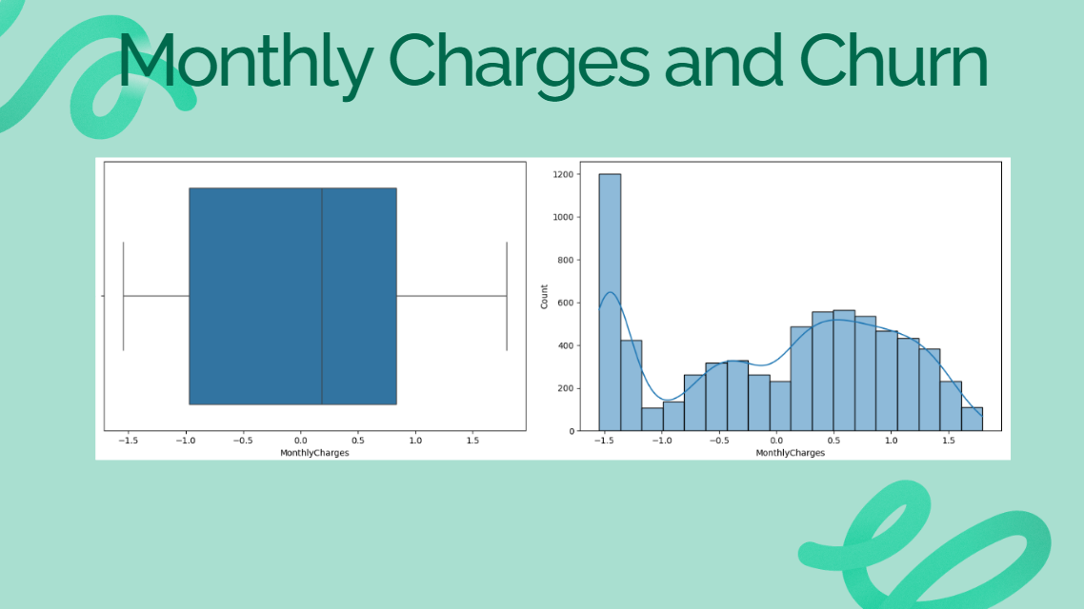
Notes:
Observation: Monthly Charges and Customer Behavior
Story: Imagine you’re fertilizing your trees. The trees that require the most expensive fertilizer (higher monthly charges) are harder to sustain because they demand more resources. Some may not justify their cost, so they’re more likely to be removed (churn). Offering affordable, balanced fertilizers (cost-effective pricing) could keep them thriving. (examples of solutions: (extra care (promo’s, deals, offers, upgrades, to ensure they like you, that they want to continue their growth with you)
Monthly Charges: "One leak is the cost. Customers with high monthly charges might feel like the bucket isn’t worth the price and decide to leave."
High Charges = Higher Risk of Leaving Think of it like dining at an expensive restaurant: if the experience doesn’t match the price, customers might look for alternatives. Similarly, customers paying higher monthly charges are more likely to cancel if they don’t feel they’re getting good value.
Lower Charges = Stability Customers paying lower fees are like diners at a budget-friendly café. Their smaller bills make them less likely to leave because they feel the service is affordable and worth it.
The Balance is Key Just like a restaurant finding the right menu pricing, businesses need to balance monthly charges. Slightly higher fees can work if customers see extra value (like better support or perks). But if prices go up without adding value, customers may leave.
Insights:
Offering customized plans or value-added services for high-charging customers could help reduce churn. For instance, providing loyalty discounts, enhanced customer support, or exclusive features for these customers could make the service feel worth the price.
Encouraging customers to switch to bundled or discounted annual plans could also stabilize the customer base.
Higher monthly charges correlate with increased churn. Customers paying more might be more sensitive to price, leading to cancellations.

Slide 6
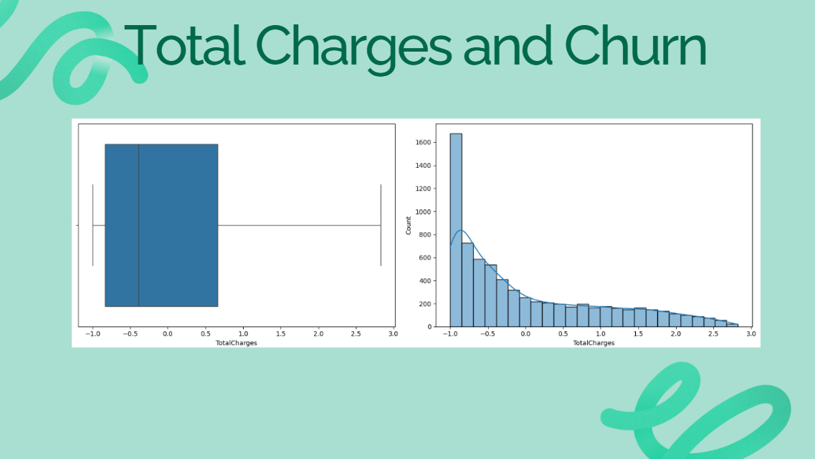
Notes:
What is Total Charges x Churn? Story: Total Charges: "Another factor is time. Customers who have been with us longer feel more invested, while newer customers (low total charges) are at higher risk of slipping through the cracks."
Now, consider the lifespan investment you’ve made in your trees—the total amount you’ve spent on fertilizers, water, and care over time. Trees with low total investment (low total charges) are typically young, less rooted, and more prone to being neglected or removed (churn).
On the other hand, trees with high total investment (high total charges) represent your long-standing, well-cared-for assets. They’ve been in your forest longer and have brought stability, shade, and beauty. However, even these mature trees need consistent maintenance to remain healthy. A sudden drought (poor customer service) or competitor offering a better forest (another company) could still make them vulnerable.
Longer Relationships = Higher Total Charges Think of a long-time gym member. Over the years, their total fees add up, making them a loyal customer. In this case, customers with high total charges likely represent those who have stayed longer with the company.
Newer Customers = Higher Risk of Leaving Imagine someone who just joined a gym but hasn’t yet settled into a routine. Customers with low total charges are like these new members—they’re more likely to leave because they haven’t built enough trust or value in the service.
Key Takeaway Total charges show us a strong trend: longer relationships are worth nurturing. To reduce churn, businesses should focus on helping new customers feel valued and build loyalty early on.

Slide 7
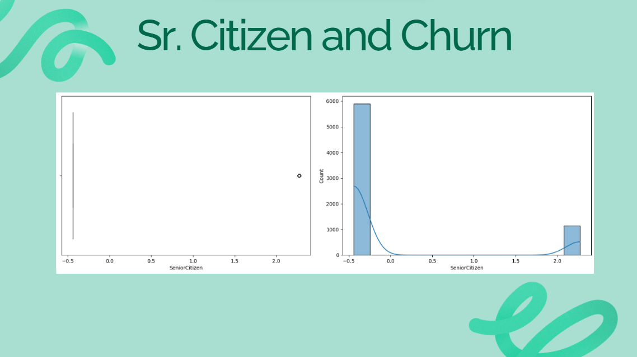
Notes:
What is Sr Citizen x Churn? Story: Senior Citizens: "Some customers, like senior citizens, might have different needs or expectations. If these aren’t met, it creates another leak in the bucket."
In your forest, imagine that some trees are older, majestic oaks (senior citizens). These oaks have stood tall for years and represent a rich history of growth and investment. However, they are also more susceptible to harsh winds and environmental changes (churn triggers like poor service or high costs).
If the conditions in your forest don’t meet their unique needs, these oaks might topple or stop producing benefits (churn). Offering specialized care and stability (senior-focused services) ensures they feel valued and supported in the forest ecosystem.

Slide 8
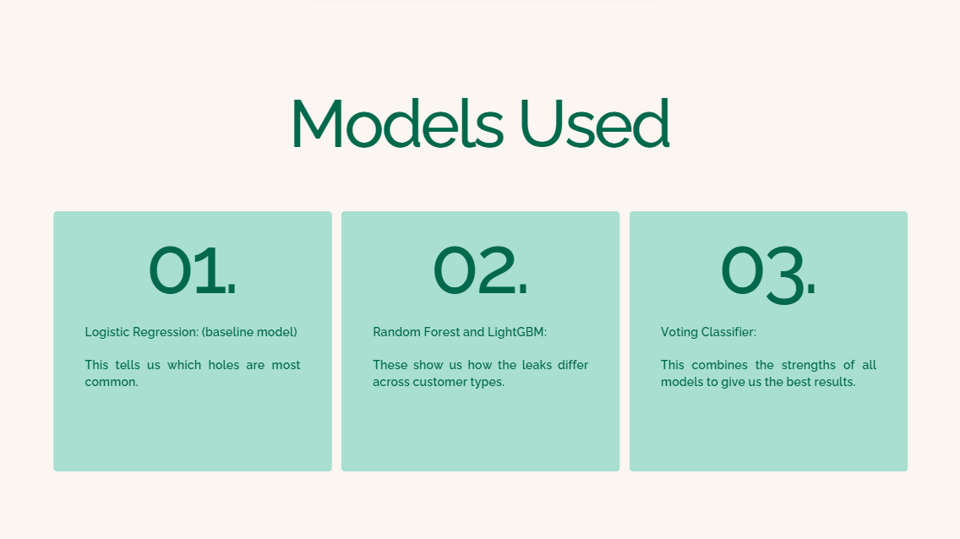
Notes:
Story: How can we patch these holes? With Modeling, we can compare and predict
Use predictive models to identify the biggest leaks:
Analogy: Modeling and Fixing the Leaks

Slide 9
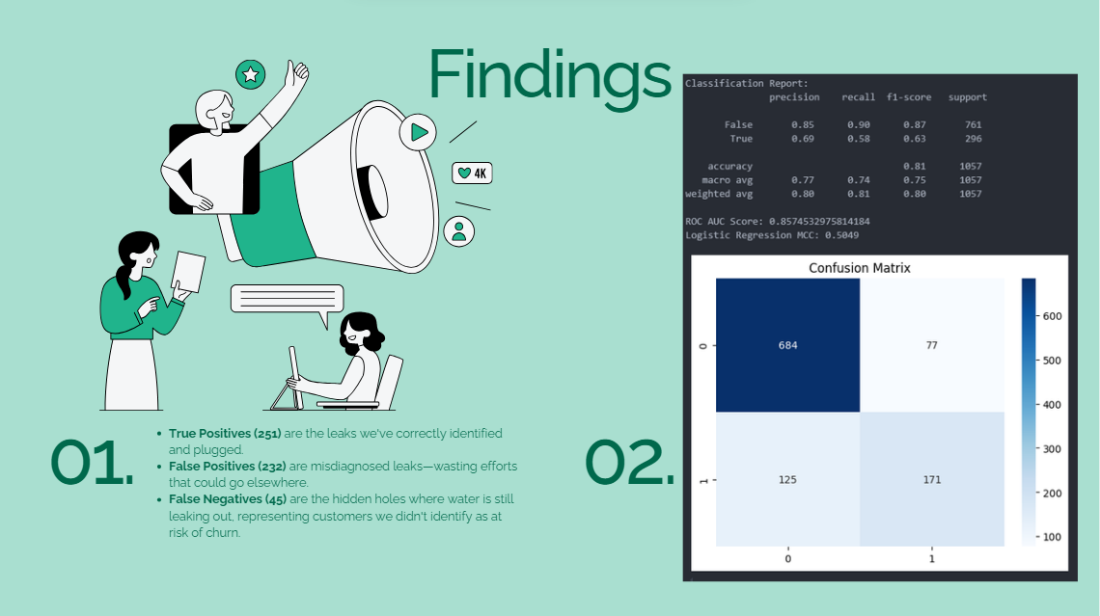
Notes:
LogReg
Logistic Regression: "This tells us which holes are most common."
Modeling and Fixing the Leaks What're insights from the plots?
Is there a hypothesis? Should we explore? Insights from the Plots
Confusion Matrix:
Imagine a bucket meant to hold water (revenue). In this case, "water" represents customers.
True Positives (251) are the leaks we've correctly identified and plugged.
False Positives (232) are misdiagnosed leaks—wasting efforts that could go elsewhere.
False Negatives (45) are the hidden holes where water is still leaking out, representing customers we didn't identify as at risk of churn.
Plugging these unseen leaks (False Negatives) would significantly reduce water loss (churn).
ROC Curve:
The ROC curve measures how well our "bucket" identifies leaks. A higher curve indicates a more robust bucket (model).
With an AUC Score of 0.8286, our Random Forest model is a reliable tool, though not yet perfect. We need to refine it further to catch more leaks (True Positives) while minimizing misdiagnosed leaks (False Positives).
Performance Across Folds:
AUC scores for individual folds (e.g., 0.8143 and 0.8461) indicate the model's stability. While the scores fluctuate slightly, they are consistent enough to trust the model's predictions.
—------------------------------------------------------------------------------------------------------------------------------------------------------------------------------------------------------
Is There a Hypothesis?
Yes, based on the plots:
Hypothesis 1: Customers with shorter tenure or higher monthly charges are more likely to churn. This can be explored by targeting short-term customers with incentives.
Hypothesis 2: Customers with frequent service issues or poor support experiences are more likely to churn (hidden leaks in the bucket). Investigating customer support tickets could validate this hypothesis.
Should We Explore?
Absolutely! These initial insights help us prioritize areas for deeper analysis:
Analyze False Negatives: Understand the common characteristics of churners we missed.
Investigate Monthly Charges: Why do high-charge customers leave? Are there pricing alternatives?
Examine Contract Types: Are long-term contracts reducing churn effectively?

Slide 10
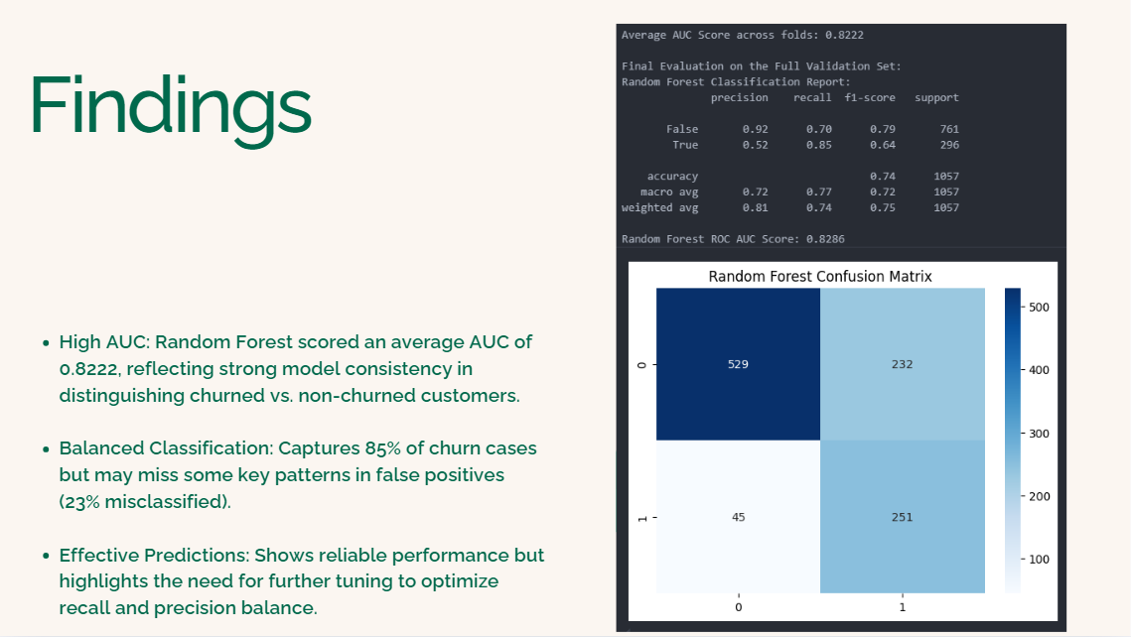
Notes:
Random Forest
Story: Visualize the water bucket as our efforts in predicting churn. The Random Forest model effectively channels most water into the right buckets (categories), but some water (misclassifications) still leaks. By understanding where the leaks occur—like certain customer profiles or behaviors—we can patch the holes and improve future models, retaining more customers.
Random Forest and LightGBM: These show us how the leaks differ across customer types.
Modeling and Fixing the Leaks What're insights from the plots?
Is there a hypothesis? Should we explore?
Random Forest
Insights from the Plots (Random Forest)
AUC Scores Across Folds:
Each fold shows how well the model distinguishes between churned and non-churned customers.
Imagine trying to fill multiple buckets with water—each fold represents a bucket, and the AUC score tells us how much water (or insight) each bucket holds. Some buckets (folds) are better at holding water than others, indicating model consistency.
Confusion Matrix:
The confusion matrix highlights correctly and incorrectly classified churn instances.
Think of the confusion matrix as trying to channel water into two distinct containers (churned and not churned). While the model channels most water correctly, some still splashes into the wrong container (misclassifications).
ROC Curve:
The ROC curve shows the balance between catching water in a large bucket (maximizing true positives) while minimizing spills (false positives).
A steep curve reflects a well-designed spout directing water effectively into the bucket, demonstrating strong model performance.
Hypothesis
Hypothesis: Customers with higher tenure and lower charges are less likely to churn.
Exploration Needed:
Are there specific demographic or behavioral trends (like tenure or seniority) associated with churn predictions?
Are the current misclassifications (splashing water) due to similar customer profiles?

Slide 11
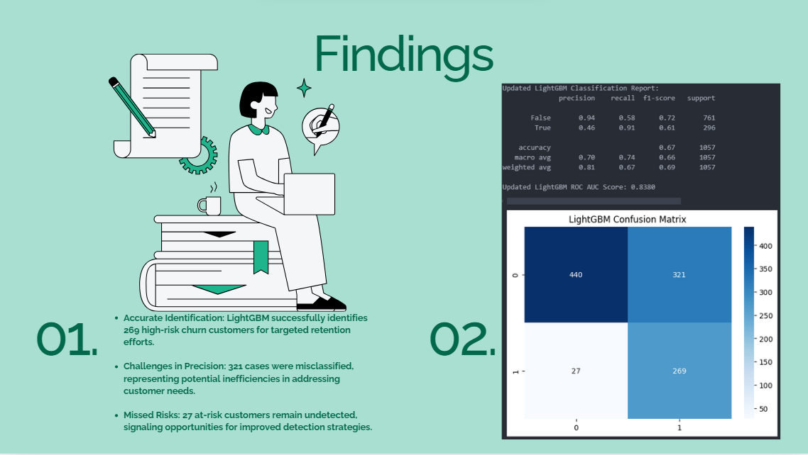
Notes:
LightGBM
Insights from the Plots (LightGBM)
Story Analogy:
Imagine managing a community garden. You aim to identify which plants (customers) are struggling to thrive (likely to churn) based on signs like wilting leaves (high charges) or shorter planting time (short tenure). The LightGBM model acts like a skilled gardener. It successfully flags most of the struggling plants (high recall), but in doing so, it also marks some healthy ones as at risk (lower precision).
The confusion matrix is our gardening log:
The plants saved (correct predictions) are valuable wins.
Misclassified plants reflect areas needing a sharper eye or better tools.
The ROC curve shows the gardener's overall efficiency in differentiating between healthy and struggling plants compared to random selection. The current performance shows promise but highlights a need for more precise pruning techniques to avoid wasting resources on healthy plants.
Insights from the Plots:
Classification Report:
The model has a recall of 0.91 for churned customers (class "True"), indicating it correctly identifies a significant proportion of customers likely to churn.
However, the precision for churn is lower at 0.46, suggesting many non-churn cases are misclassified as churn.
The overall accuracy is 67%, with an ROC AUC score of 0.8380.
Confusion Matrix:
Among the churned customers (1), 269 were correctly classified as churned, while 27 were misclassified.
Among non-churned customers (0), 440 were correctly classified, but 321 were misclassified.
ROC Curve:
The model performs significantly better than random guessing, as shown by the curve's deviation from the diagonal line.
The ROC AUC score reflects the model's ability to distinguish between churned and non-churned customers.
Hypothesis and Exploration:
Hypothesis: Customers with high monthly charges and short tenure are more likely to churn.
Exploration:
Investigate how different customer segments (e.g., contract types, senior citizens) impact model performance.
Consider tuning hyperparameters further to address the imbalance in precision and recall.
Simple Talking Points for Non-Technical Audience:
The model is strong at identifying customers at risk of leaving (91% recall), ensuring we target them effectively.
However, it occasionally mistakes loyal customers for at-risk ones (46% precision), which may lead to unnecessary interventions.
This balance between recall and precision highlights the need for further analysis to refine predictions and prioritize high-impact actions.

Slide 12
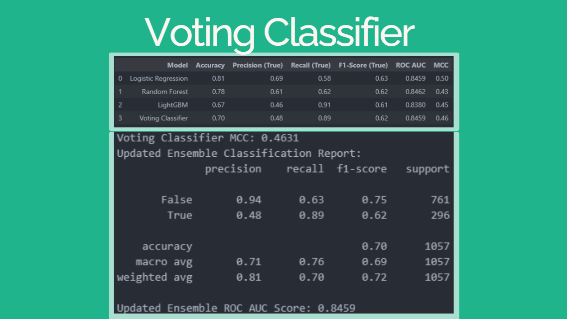
Notes:
Voting Classifier
Voting Classifier: "This combines the strengths of all models to give us the best prediction.
Think of the Voting Classifier as a well-planned irrigation system combining streams from three different water sources (models). By blending these sources, we minimize wasted water (false positives) while ensuring enough flows to the plants that need it (catching churners).
This approach allows us to balance the strengths of each model: precision from one, recall from another, and overall stability from the third, creating a robust prediction system that serves the business best.
The insights from this model tell us that combining approaches yields better results than relying on a single perspective, much like teamwork in solving complex challenges.
Modeling and Fixing the Leaks What're insights from the plots?
Is there a hypothesis? Should we explore?
Insights from the Plots:
Balanced Predictions:
The Voting Classifier, like a careful system of funnels, balances the water (predictions) flowing through different buckets (models like Logistic Regression, Random Forest, and LightGBM).
The precision, recall, and F1-score demonstrate that the Voting Classifier effectively combines predictions from its components to create a more stable outcome.
Performance Highlights:
The MCC score (0.4631) is the highest among all models, indicating the most robust performance in handling class imbalance.
The ROC Curve shows a strong true-positive rate, suggesting that the Voting Classifier does a good job identifying churners while maintaining low false-positive rates.
Hypothesis:
Hypothesis: The Voting Classifier provides more consistent and balanced predictions compared to any single model, leveraging the strengths of all three models in its ensemble.
We should explore if tuning the weights of the individual models further improves the results. For instance, could LightGBM (already contributing well to recall) have a higher weight to enhance performance?
Correlations and Trends:
The Voting Classifier combines insights from multiple models, each of which has different strengths:
Logistic Regression contributes precision (stopping leaks from non-churners being misclassified).
Random Forest adds stability, managing overall classification performance.
LightGBM enhances recall, ensuring churners are caught (even if some leaks remain in the bucket).

Slide 13
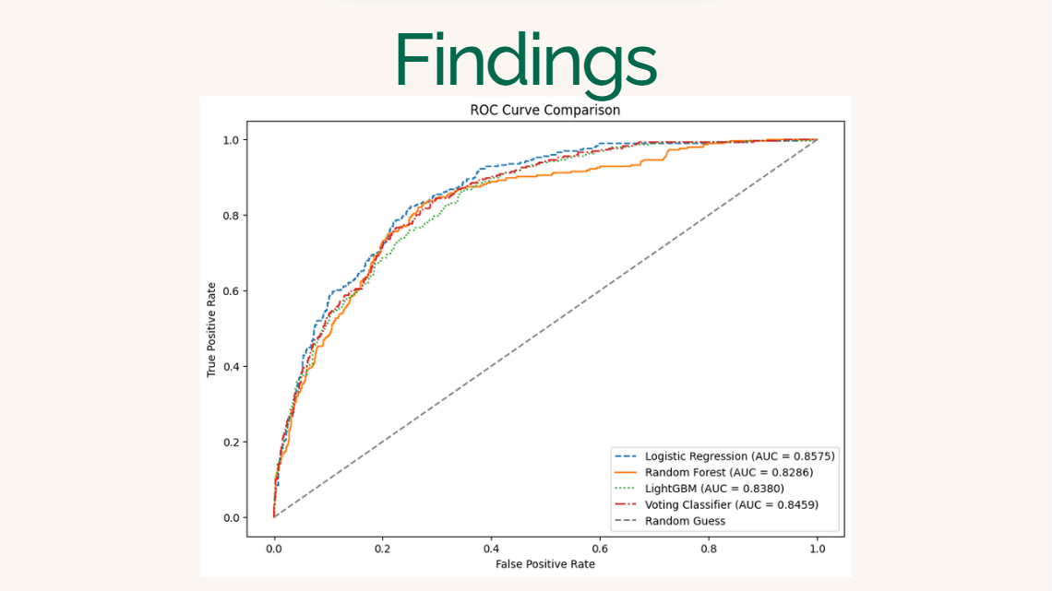
Notes:
Findings:
Highest AUC Score (0.8575): Logistic Regression outperformed other models in distinguishing churned customers from non-churned customers.
Balanced Performance: Demonstrates strong precision and recall, making it effective for identifying at-risk customers while minimizing false positives.
Optimal for Interpretation: Logistic Regression's simplicity and explainability make it a practical choice for business applications.
Story: Imagine we have a bucket with small holes representing customer churn, and we're trying to identify the leaks to patch them effectively. Logistic Regression acts like a precise scanner that identifies the exact spots where water is leaking. It doesn't overwhelm us with false alarms (false positives) and focuses on the real leaks (true positives) that need immediate attention. Its simplicity allows us to quickly understand and act, ensuring minimal water loss. This makes it the most reliable tool for the job compared to more complex scanners that might miss some leaks or sound too many false alarms.

Slide 14
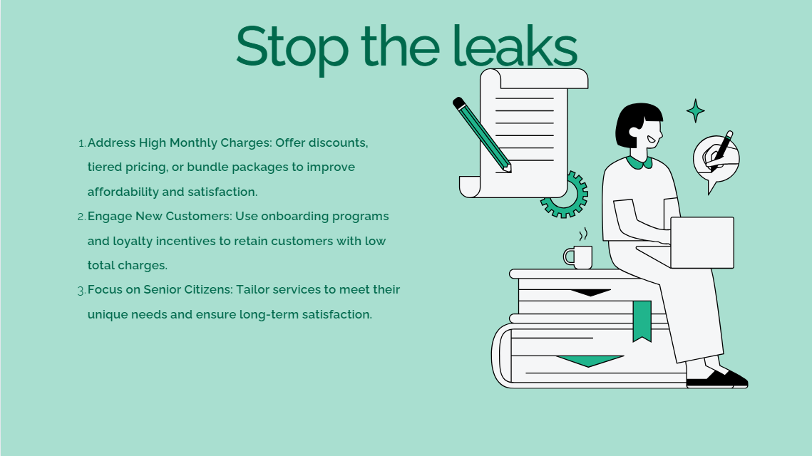
Notes:
Closing the Story
"Let’s turn the bucket into a reservoir."
Story: Imagine turning our bucket into a reservoir, where water no longer leaks but instead accumulates and strengthens the system. By understanding where the leaks occur—whether from high monthly charges, low customer engagement, or specific demographic needs—we’ve identified actionable ways to patch these holes. The goal isn’t just to retain water but to build a system that grows over time, ensuring sustainable success for the business.
"By understanding where the water leaks out, we can patch the holes and make the bucket stronger."
The Goal: "Retain customers, reduce churn, and grow the business sustainably."
Actionable Recommendations
Address High Monthly Charges:
Offer tiered pricing, discounts, or bundled packages to make services more affordable and reduce customer dissatisfaction.
Engage New Customers with Low Total Charges:
Implement strong onboarding programs, loyalty incentives, and proactive engagement to build relationships and encourage long-term retention.
Focus on Senior Citizens:
Customize services to align with their preferences and needs, ensuring they feel valued and satisfied with their experience.
"What can we do to stop the leaks?"
High Monthly Charges: Offer discounts or bundle services to make staying more affordable.
Based on churn probabilities, send targeted offers (e.g., discounts or loyalty programs) to high-risk customers identified by the models.
Create dynamic segmentation (e.g., high monthly charges, low tenure) to improve messaging and service offerings.
New Customers (Low Total Charges): Create onboarding programs and loyalty rewards to keep them engaged.
Senior Citizens: Tailor services to meet their specific needs and ensure satisfaction.
Invest in Customer Experience Improvements:
The correlation between high support calls and churn suggests improving customer support responsiveness and satisfaction.
Introduce a feedback mechanism to proactively identify dissatisfaction before customers churn.
Utilize Predictive Insights for Marketing:
Focus marketing efforts on customers flagged as medium risk to retain them before they reach high churn probabilities.
Offer tailored contract incentives (e.g., discounts for annual plans) for month-to-month customers.
Analyze Low-Charge Customers:
LightGBM's high recall suggests identifying new, low-charge customers who might churn due to lack of perceived value.
Develop programs or upselling strategies to increase their engagement and spending.
Monitor High Precision Metrics:
Random Forest and Voting Classifier showed strong precision for identifying loyal customers (non-churners).
Use this insight to focus retention budgets on customers most likely to stay while keeping efforts efficient.
Iterate and Monitor Models:
Periodically retrain models as new data comes in to ensure predictions align with evolving customer behavior.

Slide 15


